Slide 1
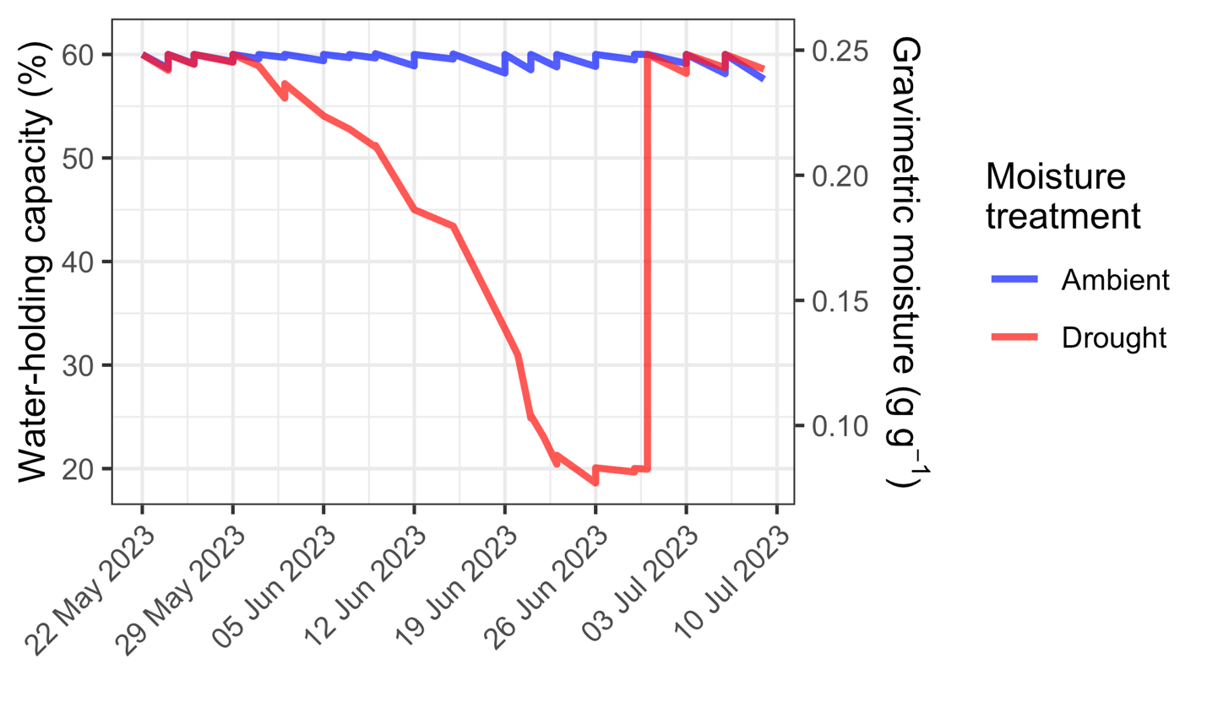
A B C
A
B
C

